Slide 1
Schedule Builder
Generate a Schedule and Register for Classes

Slide 2
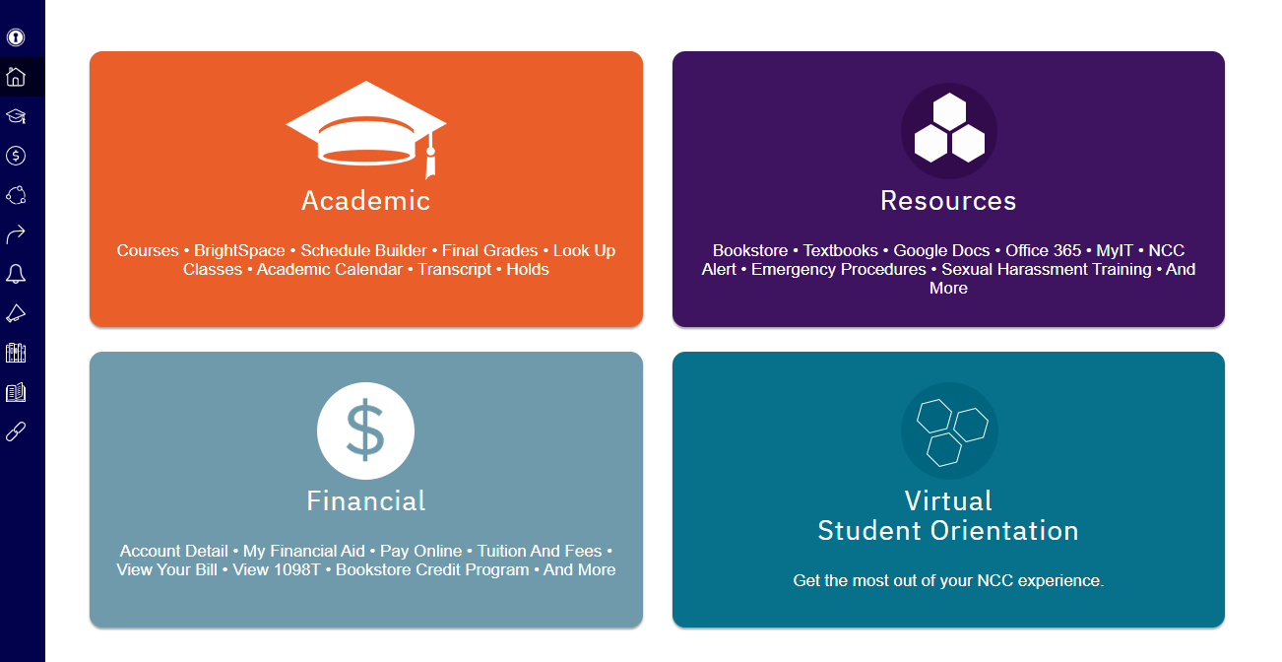
Select Academic to Access Schedule Builder

Slide 3
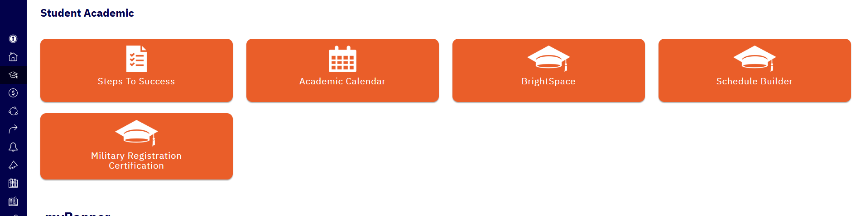
Select Schedule Builder

Slide 4
Schedule Builder is a web-based program that allows you to plan, build, and compare class schedules, add breaks, and register for classes.
Select and save your preferences and the classes you wish to take, and Schedule Builder will show you all your possible schedule options at the click of a button.
Schedule Builder also saves and remembers all your preferences, schedules, and course selections, even if you close your browser.

Slide 5
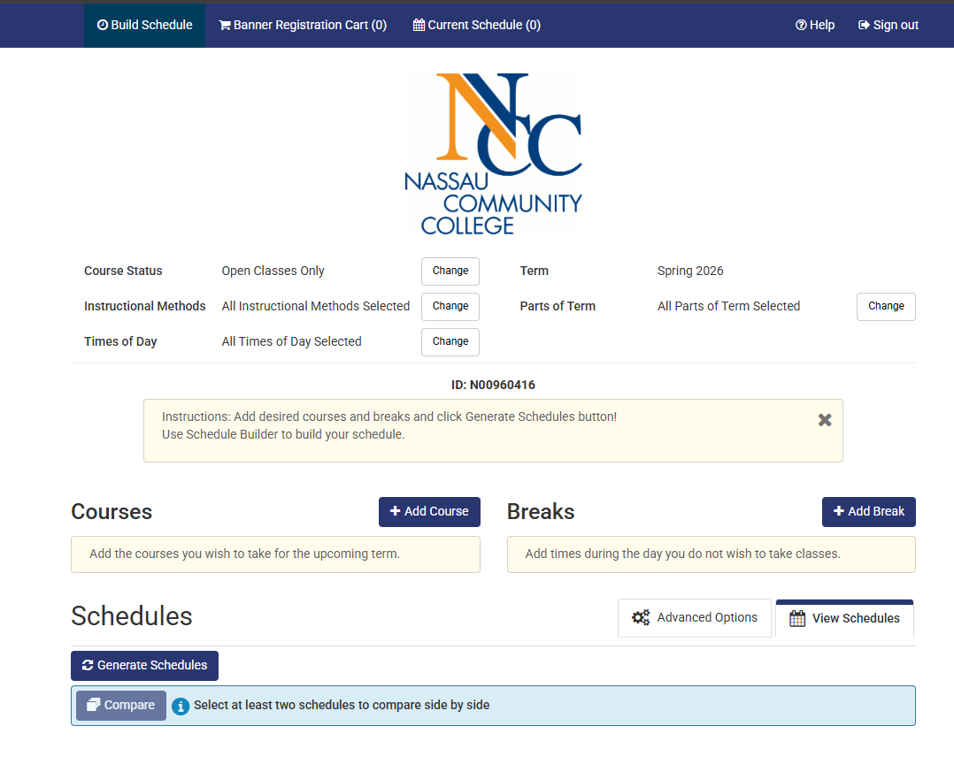
Go to Build Schedule

Slide 6
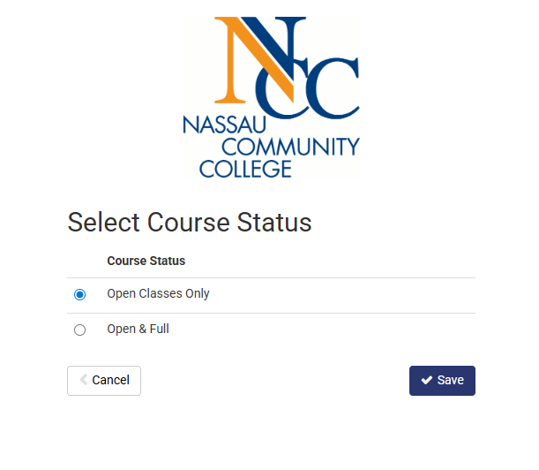
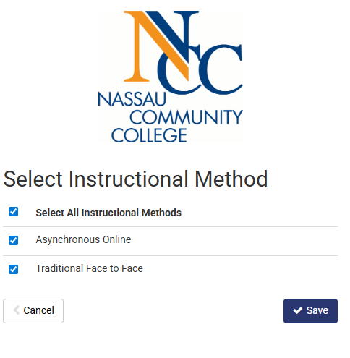
Select the filters you wish to use and save your selections. Schedule Builder will remember all your choices even after you close your browser.
Select Course Status
Select Instructional Method

Slide 7
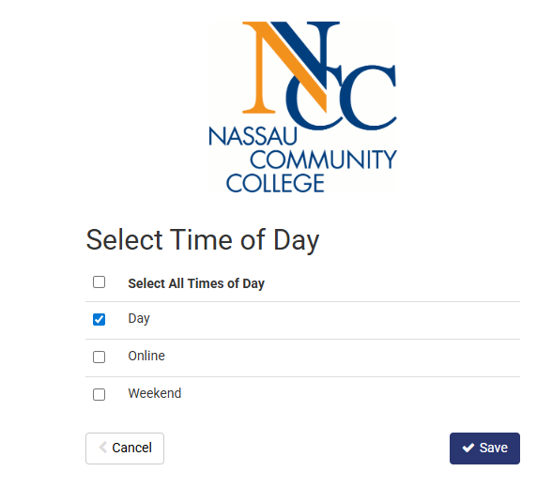
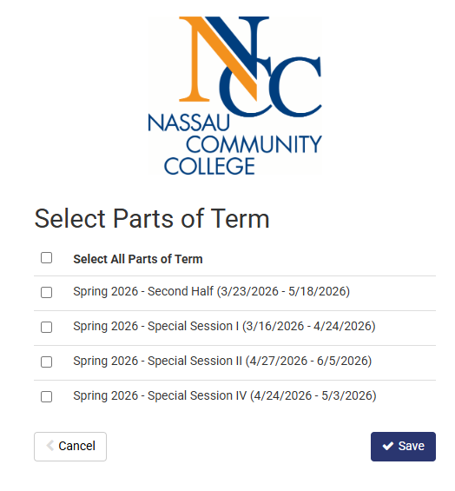
To Narrow your Search Parameters; Select Time of Day and
Select Parts of Term and Save
Select Time of Day
Select Parts of Term

Slide 8
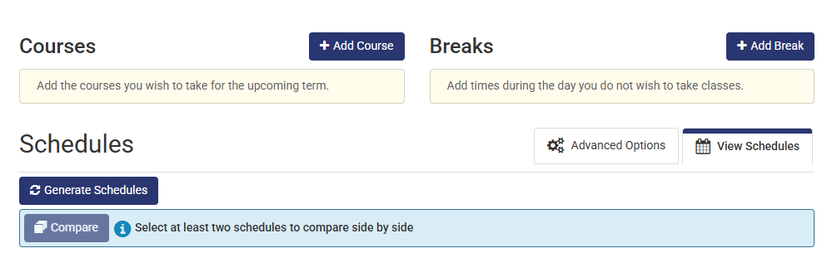
+Add Course to enter each course you wish to enroll in. +Add Break if there are times and days you do not wish to attend classes.

Slide 9
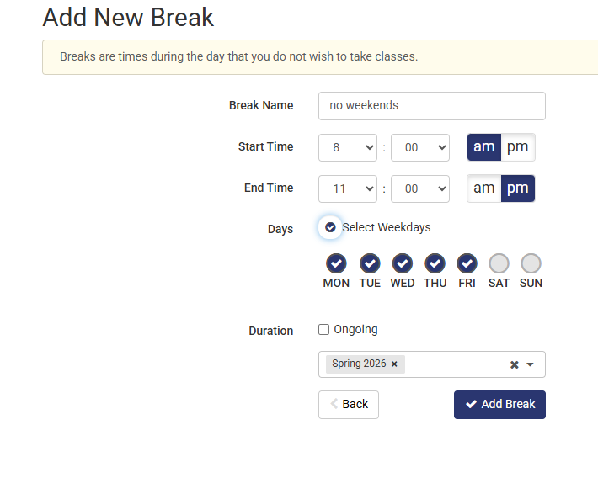
Adding a Break will narrow your parameters when generating the schedule.
Must add Break Name
Select Add Break to save your breaks

Slide 10
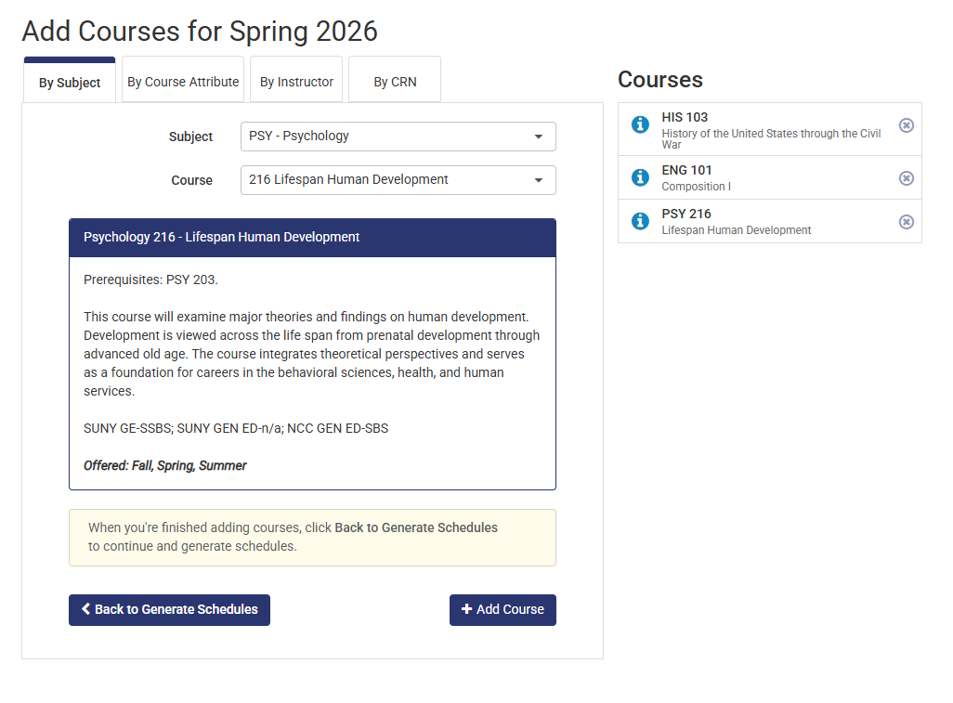
Add Courses By: Subject, Course Attribute, Instructor or CRN (Course Reference Number)
Ex. Course Search by Subject and Course Number selected from drop down menu
Course Description also includes prerequisites and/or corequisites
Select to Add Course

Slide 11
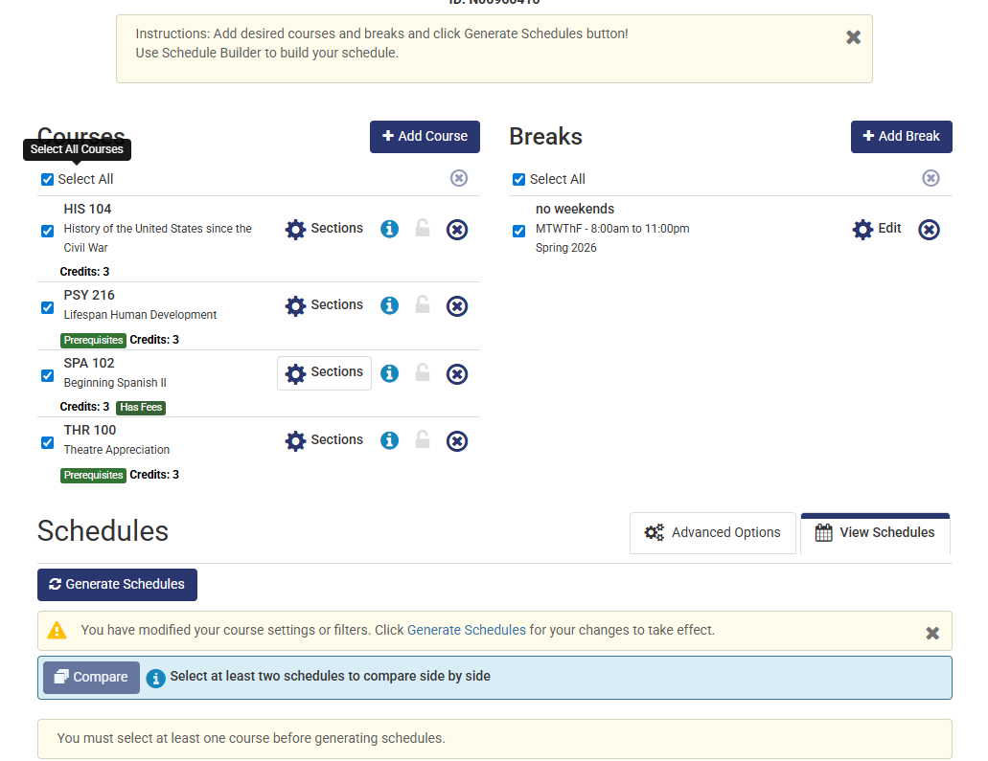
Select or Remove the Courses you want to Generate Schedule
Allows you to remove course

Slide 12
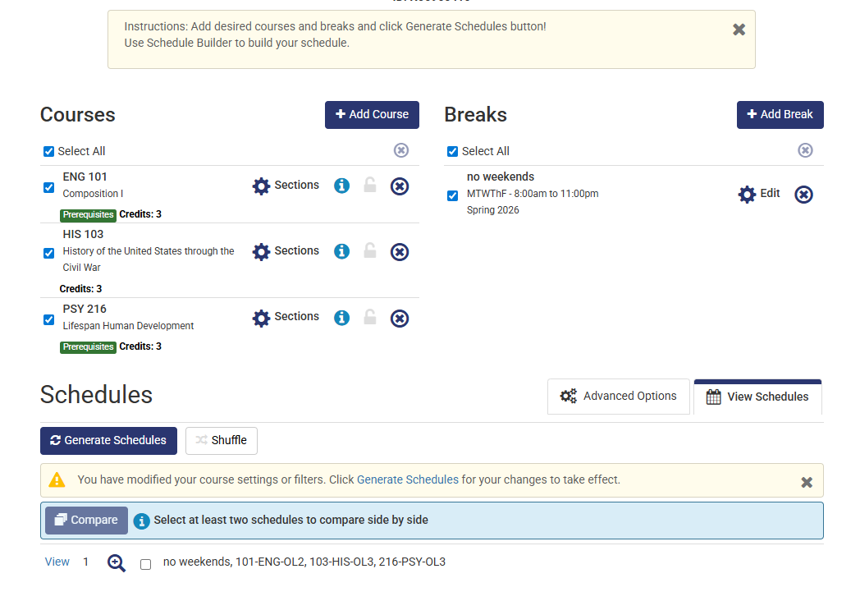
Generate Schedules and Select View to see your Schedule Options with your Selected Courses and Breaks
You can remove a course by clicking on the x

Slide 13
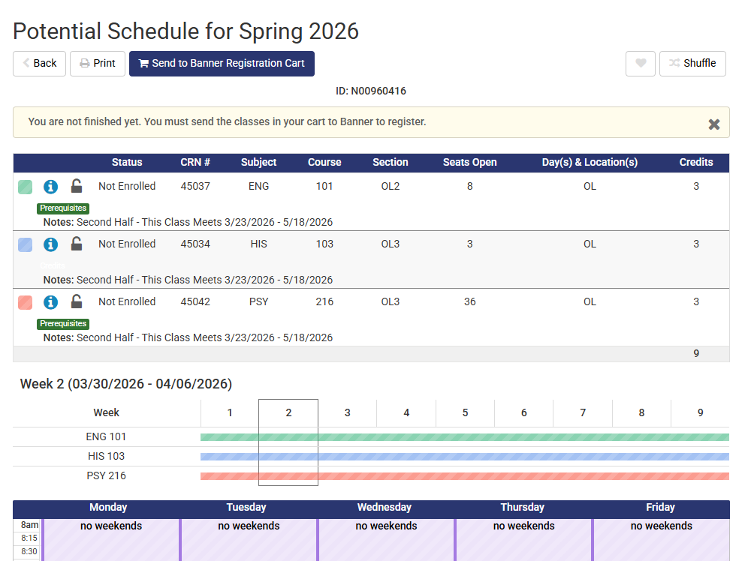
View Schedule Selected this sample only has OL online sections

Slide 14
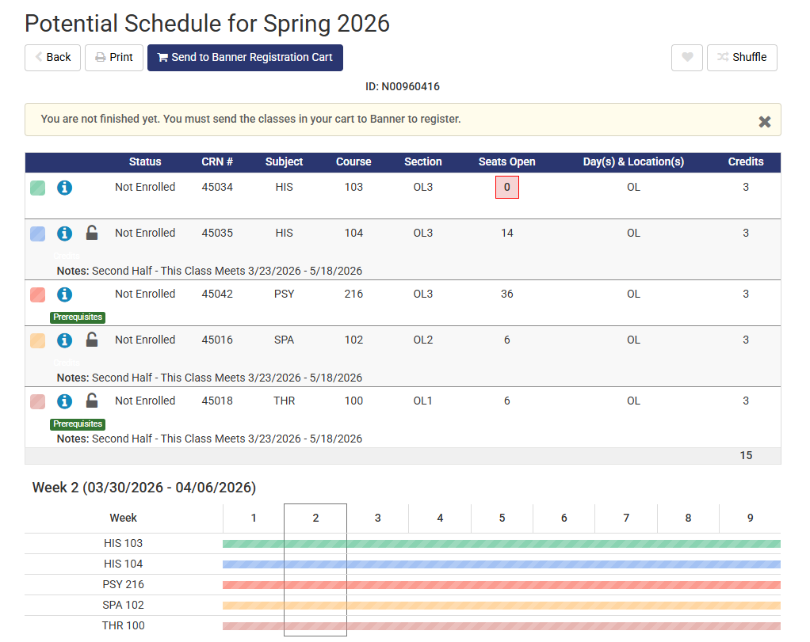
Select Potential Schedule to Send to Banner Registration Cart

Slide 15
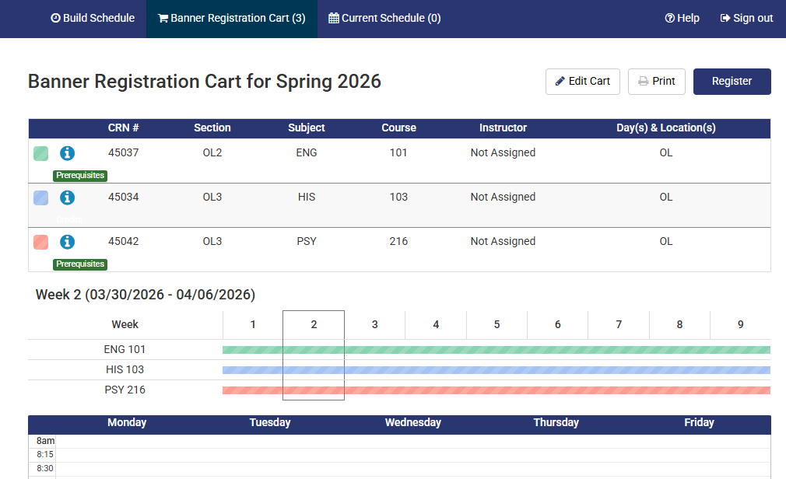
From Banner Registration Cart, Select Register

Slide 16
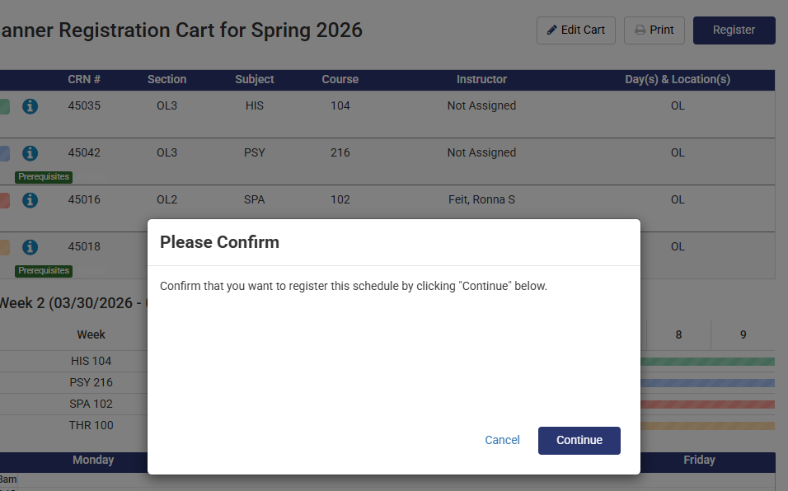
Select Continue to Confirm your Schedule

Slide 17
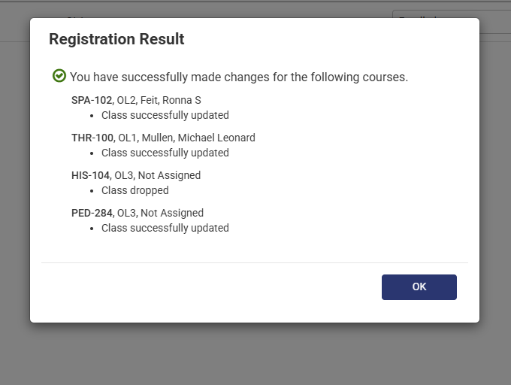
Registration Results message for each individual class
Select OK below

Slide 18
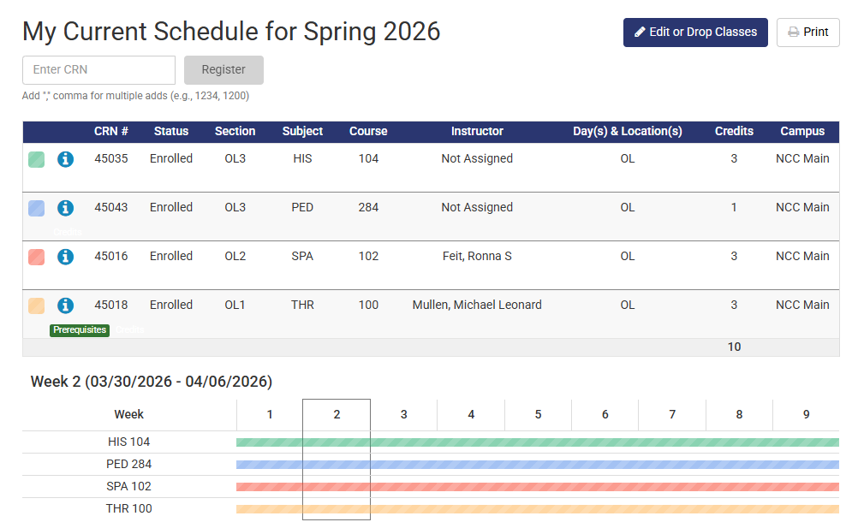
Current Schedule color coded by Subject
Schedule by Week
Color Code

