Slide 1
Other Worksheets in Degree Works
History, What If and Look Ahead

Slide 2
History
On the History worksheet, you will see a drop-down menu under Historic Report. This menu will list any audit you previously ran by date.
These reports are useful to compare past audits and review your academic progress over time.
Click History, select the date of the Audit you wish to open from the menu and click View.

Slide 3
What If Audit
The What-If Audit is listed under the worksheets tab, in the left column. This audit is a tool for you and your advisor to use if you want to consider making a change in your curriculum. For example use What If for:
Change in Degree
Change in Major
Change in Minor
What If allows you to choose alternative academic programs and quickly ascertain what the program requirements would be if you change to that program.
Use What If Audits as a Planning Tool
Audits are flexible for viewing Academic Requirements by Degree, Major, Minor and Academic Year.
Audit Reports are individual to each student based on courses and credits completed to date.
System Disclaimer Note: Use caution when requesting a What If audit as it is an unofficial report for a program in which you are not enrolled.

Slide 4
What If Audit – First Section
Click the What if tab on the left side of screen. There are two sections, in the the first you can enter alternate programs and the second enter future areas of study if desired. Your audit report is based on choices you select in each section. Note: In progress and preregistered classes are checked and display by default but may be unselected..
You can also audit against requirements for different catalog years.
To generate data In the first section, click the drop-down arrow and select the major you are considering and want to audit against. The item will move to the window on the right.
If you decide not to include an item, select it and click on the Remove button to delete.
If there are no additional areas of study to be considered or future courses to be entered, click the Process What If button.

Slide 5
What If Audit – Second Section
When you scroll down to the second section of your What If audit, you can enter courses that you may be planning to complete in the future. Any future classes you enter will be included on your What If audit report.
Enter the course as the subject, for example, Ant. for anthropology and then the course number.
Click on Add Course to include it in the box on the right. You can repeat these steps to add other courses if you choose.
To make a change or remove a course, select the course you wish to delete and click the Remove Course button.
When finished, click the Process What If button at the top center of the first screen.

Slide 6
What If Audit (cont.)
For a reminder of the programs, courses or catalog year you are considering when reviewing your audit, click the drop-down arrow next to the selected What If items or the Look Ahead Courses Used button.
Scroll down to view the requirements and see where classes will fall if you make the proposed changes to your academic program.
Click the back button to return if you want to run another audit.

Slide 7
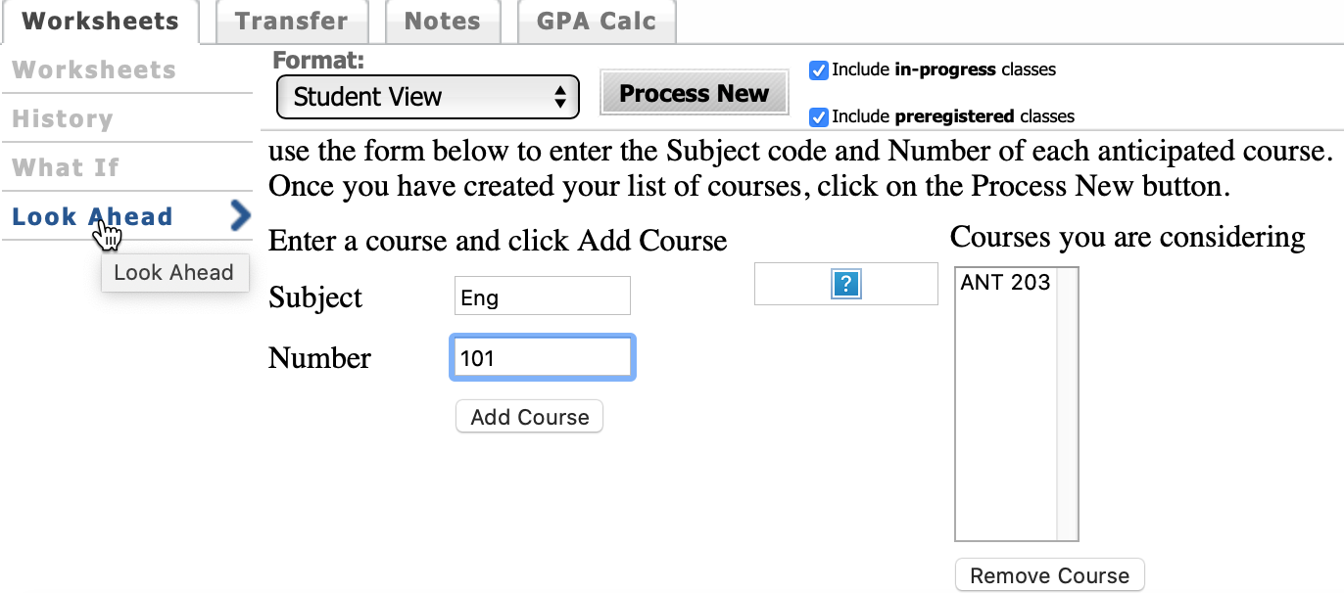
Look Ahead Audit
Use Look Ahead to see where courses you are interested in taking will fall in your audit and how they might fulfill or impact your graduation requirements. The Look Ahead feature is also available in the What if Worksheet.
Click Look Ahead on the Left side of the screen. In progress and preregistered classes are checked and display by default. Enter the subject and course number for the classes you are considering, click Add Course or click Find to search for course information. Your courses will be listed on the right. If you enter a course incorrectly, select the course and click Remove Course.
Click Process New to run your Look Ahead Audit.

Slide 8
Look Ahead Audit (cont.)
For a reminder of the courses you are considering when reviewing your audit, click the Drop-Down arrow next to the Look Ahead Courses Used button.
Scroll down to see requirements and where the courses will fall. Course(s) will appear in Blue in the In-Progress block with the word Planned next to them.
Notice that Anthropology 203 will satisfy a Social Science elective. However, Eng. 101 is listed in the Not Used for Major section because the student previously took this course.

